Slide 1

Chapter 8
Cloud Computing
Technology and Information Systems

Slide 2
Learning Objectives
By the end of this lecture, you will be able to understand:
The basic concepts of cloud computing
The basic cloud service models
The cloud computing deployment models
Advantages of cloud computing
Challenges of cloud computing
Top 10 Cloud Service Providers in 2023
© 2017 by McGraw-Hill Education

Slide 3
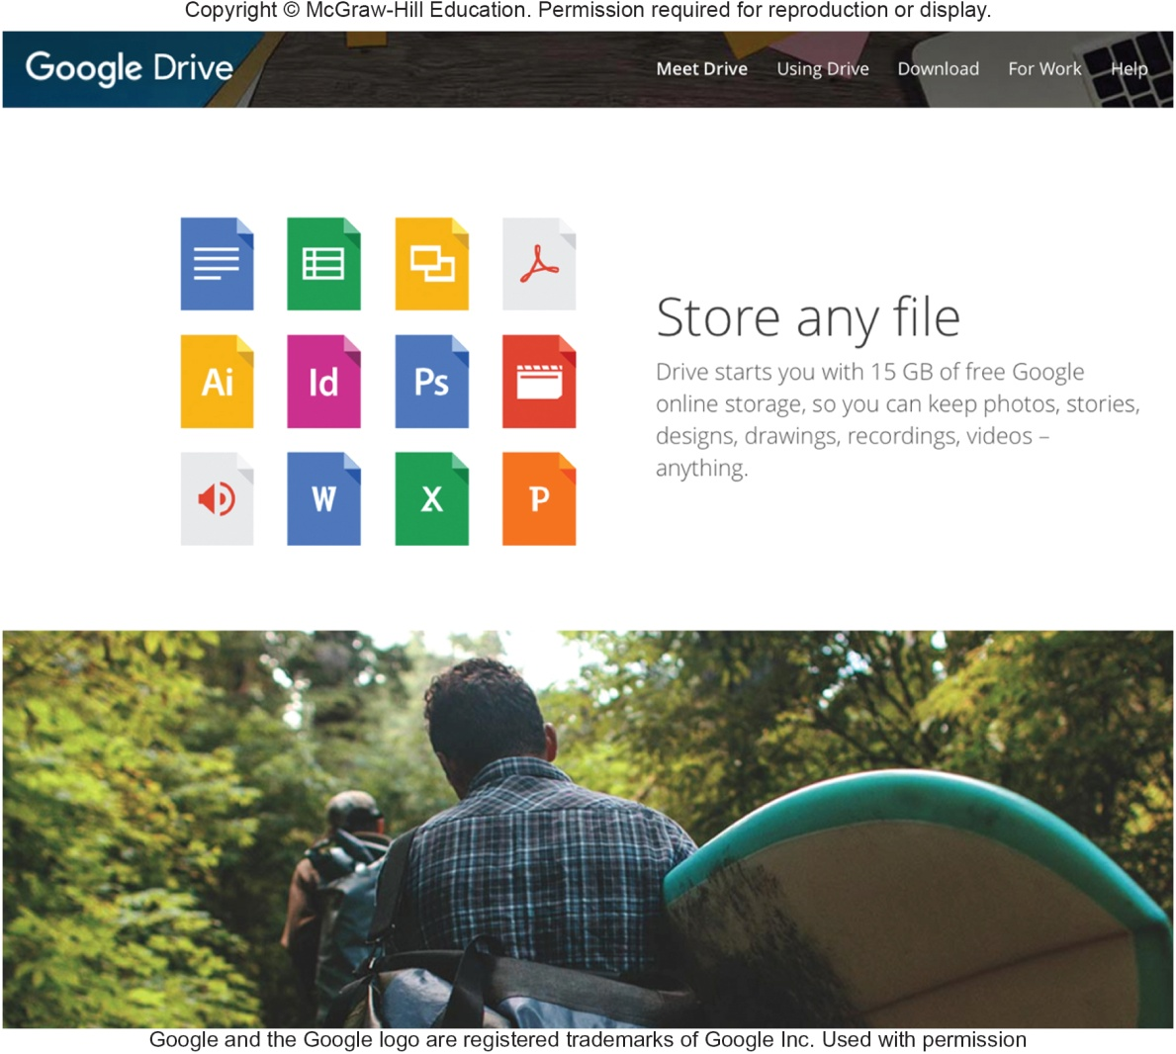
Cloud Storage
The Internet acts as a “cloud” of servers
Applications provided as a service rather than a product
Supplied by servers that provide cloud storage or online storage
© 2017 by McGraw-Hill Education

Slide 4
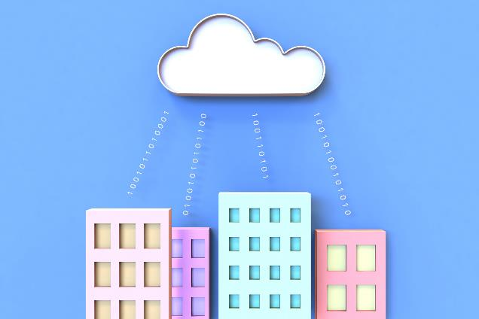
Cloud Computing Defined
Cloud computing is the on-demand delivery of compute power, database, storage, applications, and other IT resources via the internet with pay-as-you-go pricing.
© 2019 Amazon Web Services, Inc. or its Affiliates. All rights reserved.

Slide 5
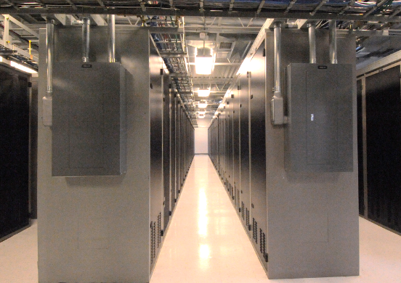

Infrastructure as Software
Cloud computing enables you to stop thinking of your infrastructure as hardware, and instead think of (and use) it as software.
© 2019 Amazon Web Services, Inc. or its Affiliates. All rights reserved.

Slide 6
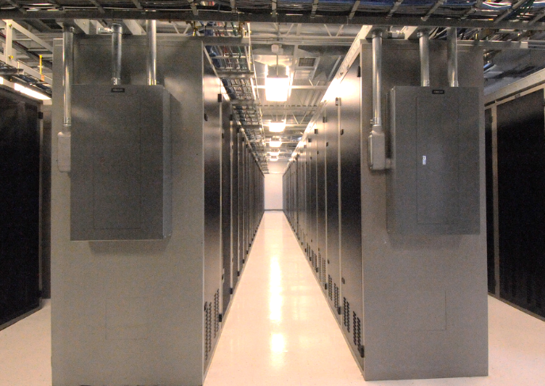
Traditional Computing Model
Infrastructure as hardware
Hardware solutions:
Require space, staff, physical security, planning, capital expenditure
Have a long hardware procurement cycle
Require you to provision capacity by guessing theoretical maximum peaks
© 2019 Amazon Web Services, Inc. or its Affiliates. All rights reserved.

Slide 7

Cloud Computing Model
Infrastructure as software
Software solutions:
Are flexible
Can change more quickly, easily, and cost-effectively than hardware solutions
Eliminate the undifferentiated heavy-lifting tasks
© 2019 Amazon Web Services, Inc. or its Affiliates. All rights reserved.

Slide 8

Cloud Service Models
IaaS
(infrastructure as a service)
PaaS
(platform as a service)
SaaS
(software as a service)
More control over IT resources
Less control over IT resources
© 2019 Amazon Web Services, Inc. or its Affiliates. All rights reserved.

Slide 9
Cloud Service Models
There are three main cloud service models. Each model represents a different part of the cloud computing stack and gives you a different level of control over your IT resources:
Infrastructure as a service (IaaS)
Platform as a service (PaaS)
Software as a service (SaaS)
© 2019 Amazon Web Services, Inc. or its Affiliates. All rights reserved.

Slide 10
Cloud Service Models - IaaS
Infrastructure as a service (IaaS)
Services in this category are the basic building blocks for cloud IT and typically provide you with access to networking features, computers (virtual or on dedicated hardware), and data storage space.
IaaS provides you with the highest level of flexibility and management control over your IT resources.
It is the most similar to existing IT resources that many IT departments and developers are familiar with today
© 2019 Amazon Web Services, Inc. or its Affiliates. All rights reserved.

Slide 11
Cloud Service Models - PaaS
Platform as a service (PaaS)
Services in this category reduce the need for you to manage the underlying infrastructure (usually hardware and operating systems) and enable you to focus on the deployment and management of your applications.
© 2019 Amazon Web Services, Inc. or its Affiliates. All rights reserved.

Slide 12
Cloud Service Models - SaaS
Software as a service (SaaS)
Services in this category provide you with a completed product that the service provider runs and manages.
In most cases, software as a service refers to end-user applications.
With a SaaS offering, you do not have to think about how the service is maintained or how the underlying infrastructure is managed.
You need to think only about how you plan to use that particular piece of software.
© 2019 Amazon Web Services, Inc. or its Affiliates. All rights reserved.

Slide 13
Cloud Service Models - SaaS
Software as a service (SaaS)
A common example of a SaaS application is web-based email, where you can send and receive email without managing feature additions to the email product or maintaining the servers and operating systems that the email program runs on.
© 2019 Amazon Web Services, Inc. or its Affiliates. All rights reserved.

Slide 14
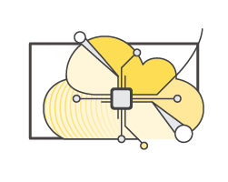
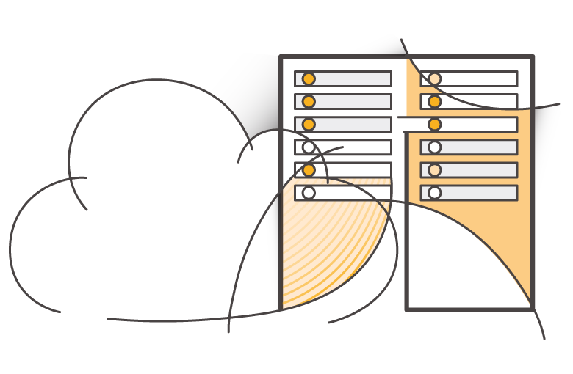
Cloud Computing Deployment Models
Cloud
Hybrid
On-premises (private cloud)
© 2019 Amazon Web Services, Inc. or its Affiliates. All rights reserved.

Slide 15
Cloud Computing Deployment Models
There are three main cloud computing deployment models, which represent the cloud environments that your applications can be deployed in:
Cloud
Hybrid
On-premises
© 2019 Amazon Web Services, Inc. or its Affiliates. All rights reserved.

Slide 16
Cloud Computing Deployment Models - Cloud
Cloud
A cloud-based application is fully deployed in the cloud, and all parts of the application run in the cloud.
Applications in the cloud have either been created in the cloud or have been migrated from an existing infrastructure to take advantage of the benefits of cloud computing.
Cloud-based applications can be built on low-level infrastructure pieces or they can use higher-level services that provide abstraction from the management, architecting, and scaling requirements of core infrastructure
© 2019 Amazon Web Services, Inc. or its Affiliates. All rights reserved.

Slide 17
Cloud Computing Deployment Models - Hybrid
Hybrid
A hybrid deployment is a way to connect infrastructure and applications between cloud-based resources and existing resources that are not located in the cloud.
The most common method of hybrid deployment is between the cloud and existing on-premises infrastructure.
This model enables an organization to extend and grow their infrastructure into the cloud while connecting cloud resources to internal systems
© 2019 Amazon Web Services, Inc. or its Affiliates. All rights reserved.

Slide 18
Cloud Computing Deployment Models – On-premises
On-premises
Deploying resources on-premises, using virtualization and resource management tools, is sometimes called private cloud.
While on-premises deployment does not provide many of the benefits of cloud computing, it is sometimes sought for its ability to provide dedicated resources.
In most cases, this deployment model is the same as legacy IT infrastructure, but it might also use application management and virtualization technologies to increase resource utilization
© 2019 Amazon Web Services, Inc. or its Affiliates. All rights reserved.

Slide 19


Advantages of Cloud Computing
1. Trade capital expense for variable expense
Capital
Data center investment based on forecast
Pay only for the amount you consume
© 2019 Amazon Web Services, Inc. or its Affiliates. All rights reserved.

Slide 20

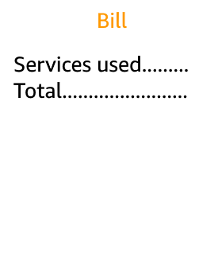


Advantages of Cloud Computing
2. Massive economies of scale
Because of aggregate usage from all customers, AWS can achieve higher economies of scale and pass savings on to customers.
AWS Cloud
Economies of scale
Savings
© 2019 Amazon Web Services, Inc. or its Affiliates. All rights reserved.

Slide 21

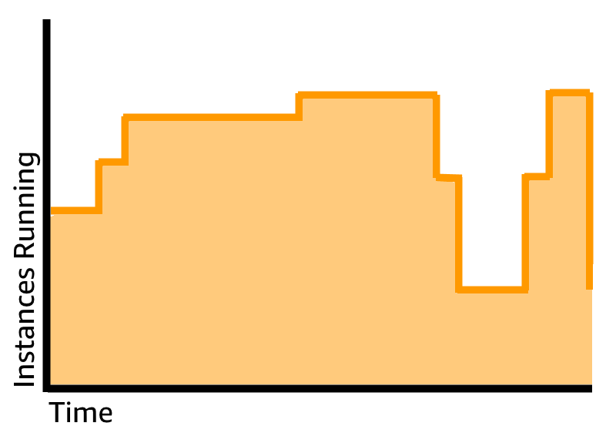
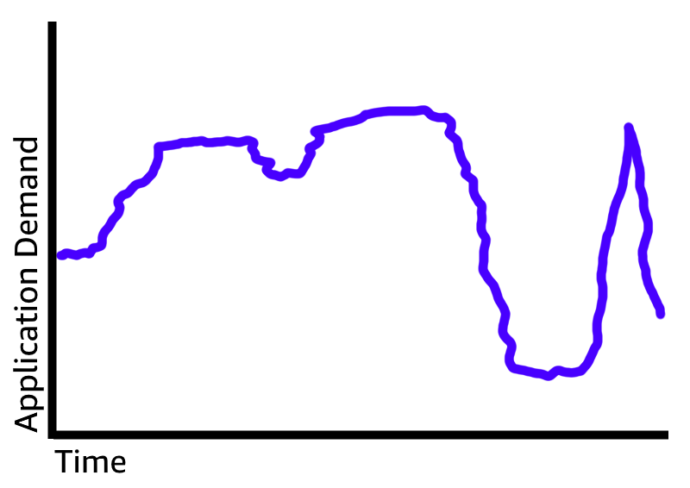
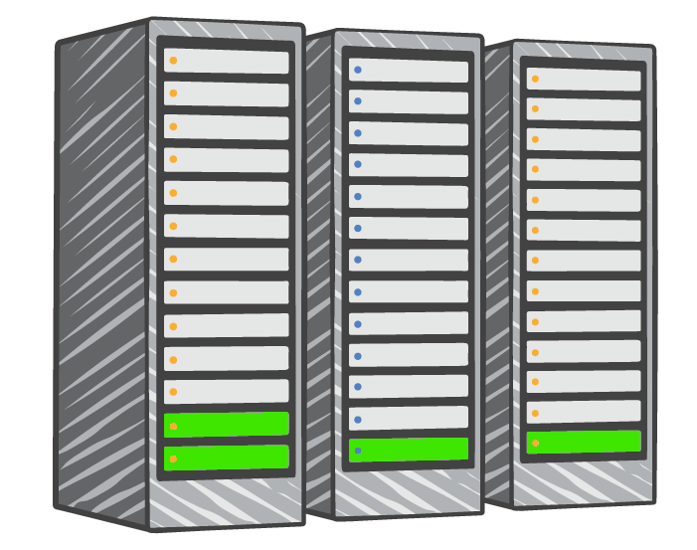

Advantages of Cloud Computing
3. Stop guessing capacity
Overestimated server capacity
Underestimated server capacity
Scaling on demand
© 2019 Amazon Web Services, Inc. or its Affiliates. All rights reserved.

Slide 22
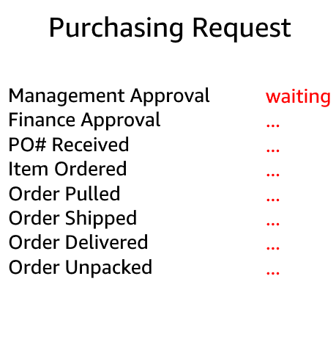

Advantages of Cloud Computing
4. Increase speed and agility
Launch
Weeks between wanting resources and having resources
Minutes between wanting resources and having resources
© 2019 Amazon Web Services, Inc. or its Affiliates. All rights reserved.

Slide 23
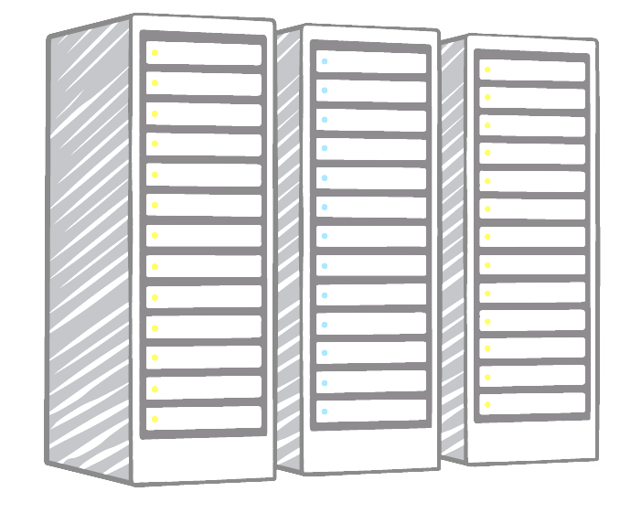



Advantages of Cloud Computing
5. Stop spending money on running and maintaining data centers
Payroll …. … .. … …. … .. … …. … .. … …. … .. … …. … .. … …. … .. …
Utilities …. … .. … …. … .. … …. … .. … …. … .. … …. … .. … …. … .. …
Maintenance …. … .. … …. … .. … …. … .. … …. … .. … …. … .. … …. … .. …
Landscaping …. … .. … …. … .. … …. … .. … …. … .. … …. … .. … …. … .. …
Hardware …. … .. … …. … .. … …. … .. … …. … .. … …. … .. … …. … .. …
Investment
Running data centers
Business and customers
© 2019 Amazon Web Services, Inc. or its Affiliates. All rights reserved.

Slide 24
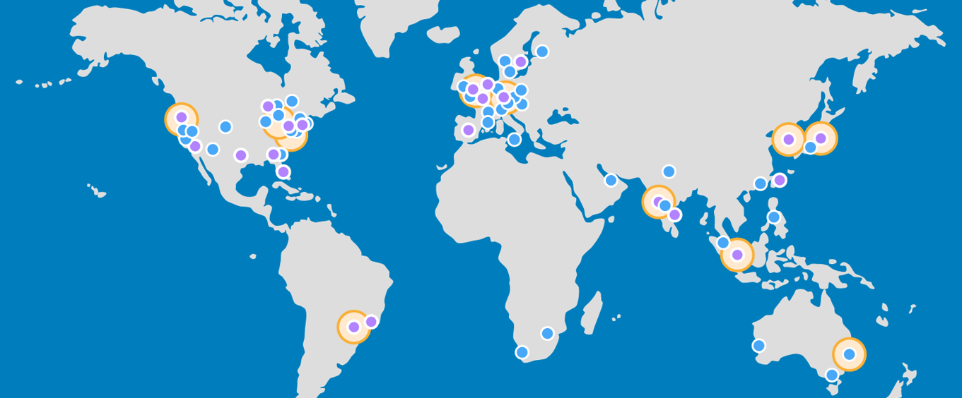

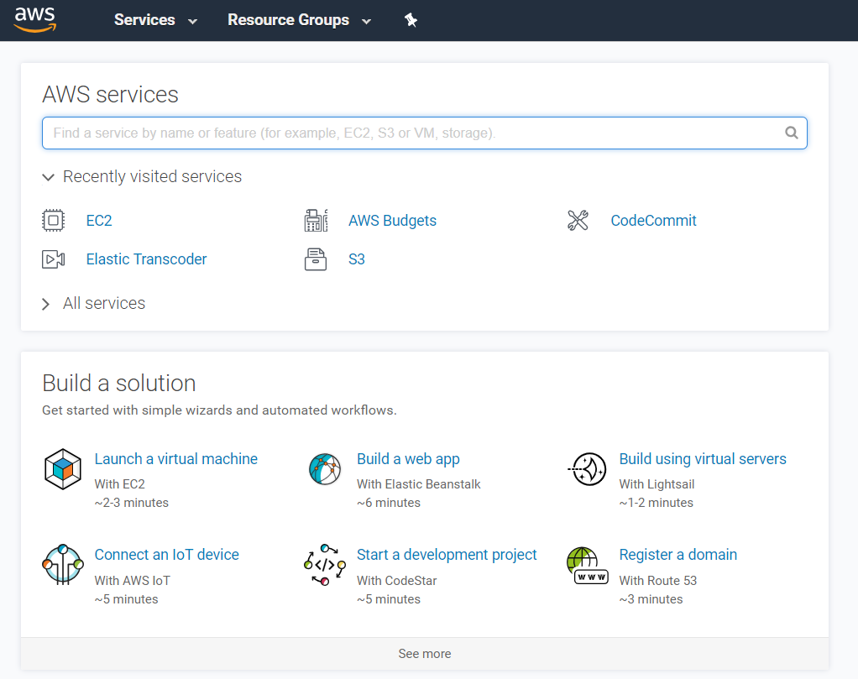
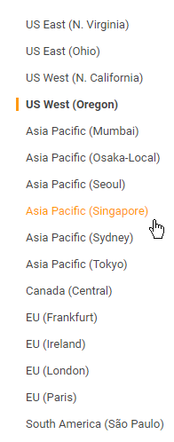
Advantages of Cloud Computing
6. Go global in minutes
© 2019 Amazon Web Services, Inc. or its Affiliates. All rights reserved.

Slide 25
Challenges of Cloud Computing
Policy and organizational issues
Technical issues
Legal issues
Source: M’rhaoaurh I., Okar C., Namir A., and Chafiq N., “Challenges of cloud computing use: A systematic literature review”, In the Proceedings of MATEC Web of Conferences 200 (IWTSCE’18), 00007, 201

Slide 26
Challenges of Cloud Computing- Policy and organizational Issues
Policy and organizational issues: These are business-related IT issues that companies may confront when considering cloud computing service providers.
Lock-in vendor
Loss of governance
Compliance challenges
Supply chain failure
Source: M’rhaoaurh I., Okar C., Namir A., and Chafiq N., “Challenges of cloud computing use: A systematic literature review”, In the Proceedings of MATEC Web of Conferences 200 (IWTSCE’18), 00007, 201

Slide 27
Challenges of Cloud Computing- Technical Issues
Technical issues: These issues for the most part are well understood as part of resilient challenges of cloud computing adoption and continue to form a major obstacle to the availability and use of this technology. They are specified by the failures associated with the technologies and services furnished by the Cloud service vendor.
Malicious insiders
Shared technology
Encryption
Multi-tenancy
Source: M’rhaoaurh I., Okar C., Namir A., and Chafiq N., “Challenges of cloud computing use: A systematic literature review”, In the Proceedings of MATEC Web of Conferences 200 (IWTSCE’18), 00007, 201

Slide 28
Challenges of Cloud Computing- Technical Issues
5. Resource and service management
6. Service level agreement (SLA)
7. Denial of service (DOS)
8. Insecure interfaces and APIs
9. Data loss or leakage
10. Integrity
Source: M’rhaoaurh I., Okar C., Namir A., and Chafiq N., “Challenges of cloud computing use: A systematic literature review”, In the Proceedings of MATEC Web of Conferences 200 (IWTSCE’18), 00007, 201

Slide 29
Challenges of Cloud Computing- Technical Issues
11. Natural disaster
12. Availability
13. Loss of backups
14.Data transfer bottlenecks
15. Interoperability
Source: M’rhaoaurh I., Okar C., Namir A., and Chafiq N., “Challenges of cloud computing use: A systematic literature review”, In the Proceedings of MATEC Web of Conferences 200 (IWTSCE’18), 00007, 201

Slide 30
Challenges of Cloud Computing- Legal Issues
Legal issues: These consist of the IT-related issues that are legal in nature, and can also have a negative impact on companies using cloud computing services.
Legal jurisdiction
Data privacy and protection
Licensing risk
Subpoena and e-discovery
Source: M’rhaoaurh I., Okar C., Namir A., and Chafiq N., “Challenges of cloud computing use: A systematic literature review”, In the Proceedings of MATEC Web of Conferences 200 (IWTSCE’18), 00007, 201

Slide 31
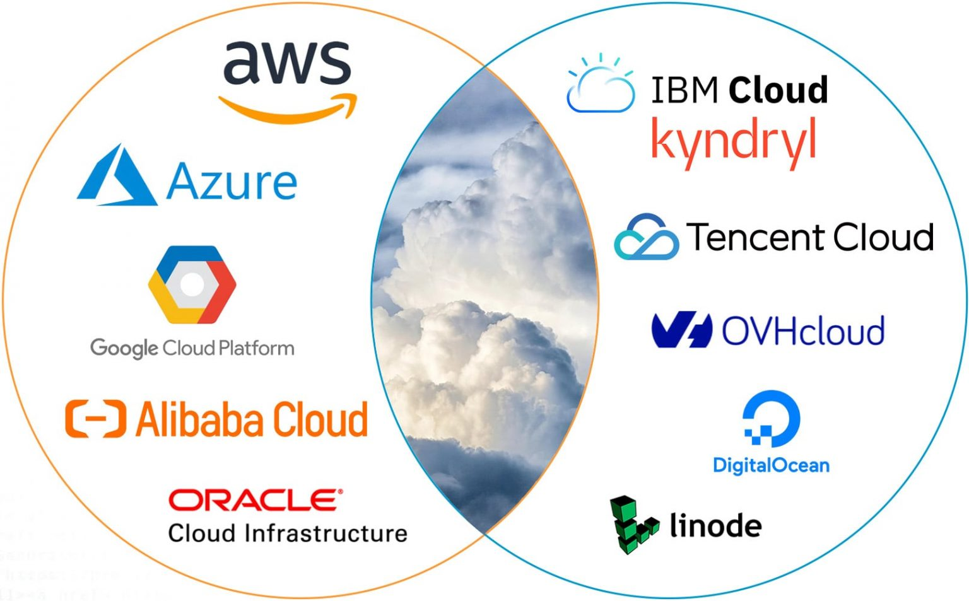
Top 10 Cloud Service Providers in 2023
Source: https://dgtlinfra.com/top-cloud-service-providers/

Slide 32
Top 10 Cloud Service Providers in 2022
# | Cloud Service Provider | Regions | Availability Zones
1 | Amazon Web Services (AWS) | 32 | 102
2 | Microsoft Azure | 62 | 120
3 | Google Cloud Platform (GCP) | 39 | 118
4 | Alibaba Cloud | 30 | 89
5 | Oracle Cloud | 46 | 56
6 | IBM Cloud (Kyndryl) | 10 | 30
7 | Tencent Cloud | 21 | 65
8 | OVHcloud | 17 | 37
9 | DigitalOcean | 9 | 15
10 | Linode (Akamai) | 20 | 20
Source: https://dgtlinfra.com/top-10-cloud-service-providers-2022

Slide 33
Microsoft Azure
Microsoft Corporation’s Intelligent Cloud segment contains Azure, the second largest cloud service provider globally.
Through Microsoft Azure, the company delivers a consistent hybrid cloud experience, developer productivity, artificial intelligence (AI) capabilities, and security & compliance.
Source: https://dgtlinfra.com/top-10-cloud-service-providers-2022

Slide 34
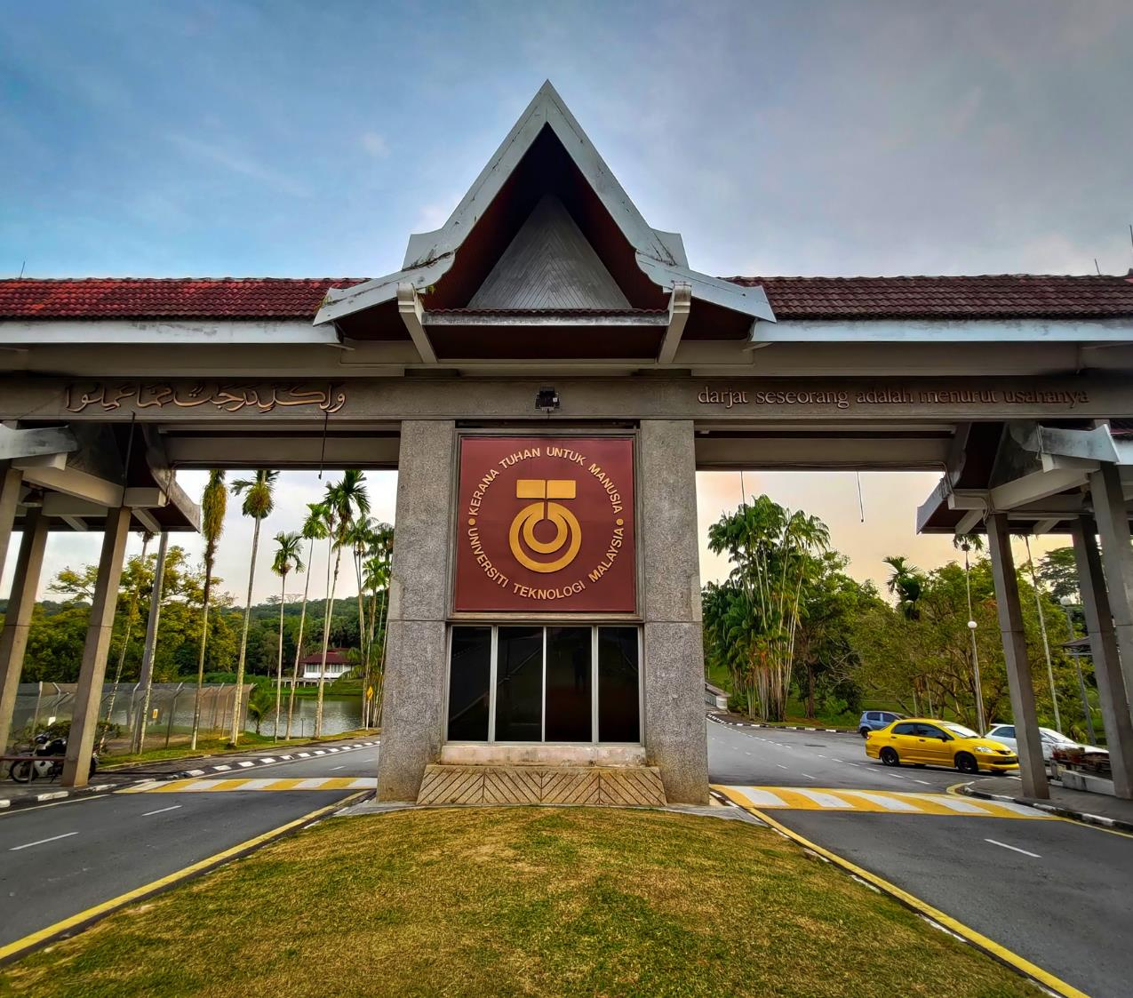
THANK YOU

